Slide 1
The Role of Local Officials in New Democracies: Evidence from Indonesia
Monica Martinez-bravo

Slide 2
Motivation
In most democratic transitions, a majority of local officials selected during the nondemocratic regime remain in their positions at the time of the first democratic election.
First democratic elections are more prone to experience electoral fraud and voter intimidation than elections in consolidated democracies.
People lack a good understanding of what incentives local officials have to engage in these practices, given the new political scenario that they face.

Slide 3
Background
The regime of General Soeharto, also known as the New Order, lasted more than 30 years, from 1966 to 1998.
The first democratic election of the post-Soeharto era took place in June of 1999.
On the same day, elections were held for the national, provincial, and district legislatures.
The village head of desa is elected by villagers every eight years for a maximum of two terms, whereas the village head of kelurahan is appointed by the head of the district.

Slide 4
Model
Assume political leanings of local officials are private information
Assume there is common knowledge about the share of the population that has a preference for party D, the dictator’s party, and denote that proportion by π.
The timing of events is as follows:
(i) Taking into account π, every village head chooses a level of effort e ∈ ℝ.
(ii) The electoral outcome is realized, and the level of effort that village heads exerted is observed. The candidate for mayor of the district who obtains the highest number of votes takes office.
(iii) The new mayor decides whether to retain or dismiss every appointed village head ϕ ∈ {0, 1}.
(iv) Payoffs are distributed, and the game ends.

Slide 5
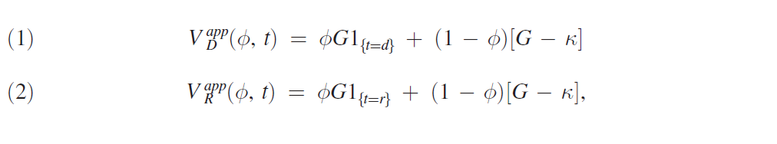
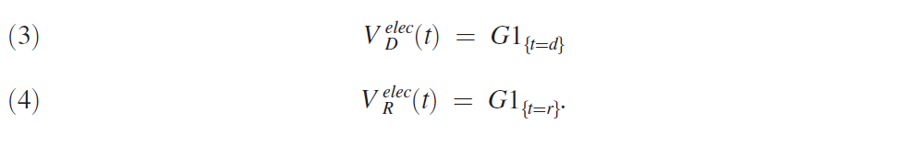
Model
Utility of district mayors D and R

Slide 6
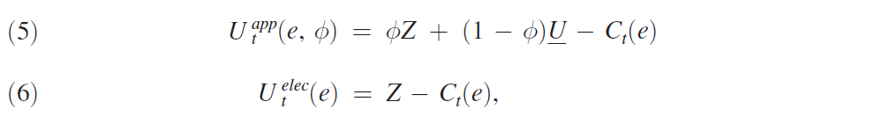
Model
Utility of village heads who are party t sympathizers are
Cost function C(~) is increasing and convex over the absolute value of effort, e
Exerting effort is more costly for a village head when he supports his least preferred candidate

Slide 7
Model
Candidate D wins the mayoral election if π-tilde is great than 1/2

Slide 8
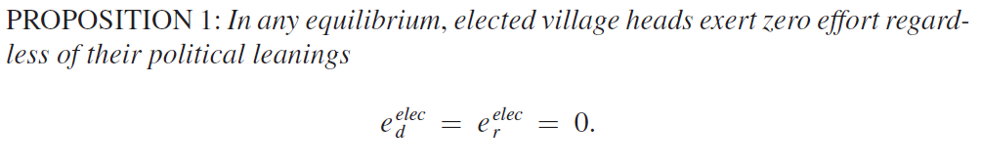
Equilibria
Since the continuity of elected village heads in their positions neither depends on which mayor wins the election nor on the strategies mayors play, it is straightforward to see that elected village heads do not find it optimal to exert effort.

Slide 9
Equilibria of the signaling game
Perfect Bayesian Equilibrium for appointed village head:
i) Pooling equilibrium:
Both types of village heads—sympathizers of party D and sympathizers of party R—exert the same level of effort and mayors cannot update their beliefs along the equilibrium path.
When the election is expected to be lopsided and one party is very likely to win, all the appointed village heads have a strong incentive to pretend to be supporters of the likely winner. It is optimal for them to do so in order to keep their jobs as village heads once the candidate becomes district mayor.

Slide 10
Equilibria of the signaling game
Perfect Bayesian Equilibrium for appointed village head:
ii) Separating equilibrium:
Types are truthfully revealed along the equilibrium path. Each type of village leads will support its favored candidate.
π, the underlying strength of party D in the district, needs to take intermediate values for this equilibrium to exist.
In other words, separating equilibria will emerge when the election is expected to be close. Intuitively, both candidates for mayor need to have possibilities of winning the election. Otherwise, some village heads would have strong incentives to deviate by pretending to be supporters of the likely winner.

Slide 11
Empirical Prediction
i) In districts in which the election is expected to be lopsided, appointed village heads unambiguously exert greater effort than elected village heads to support the likely winner of the election for mayor.
ii) The model predicts high turnover of appointed village heads in districts where a separating equilibrium emerges: types are truthfully revealed along the equilibrium path and the new mayor can identify and dismiss her nonsupporters. In contrast, in districts where a pooling equilibrium emerges we expect to observe low turnover, since there was no truthful revelation of types

Slide 12
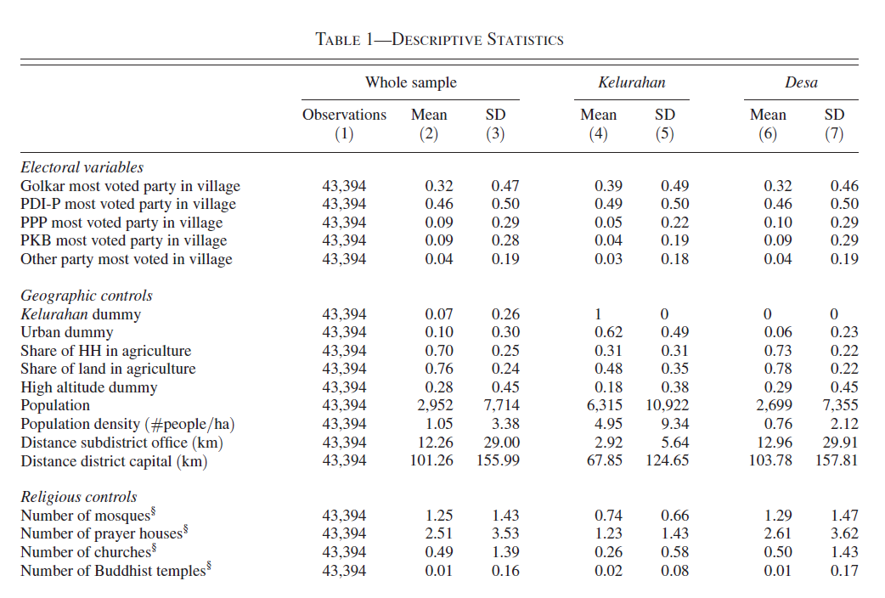
Data

Slide 13
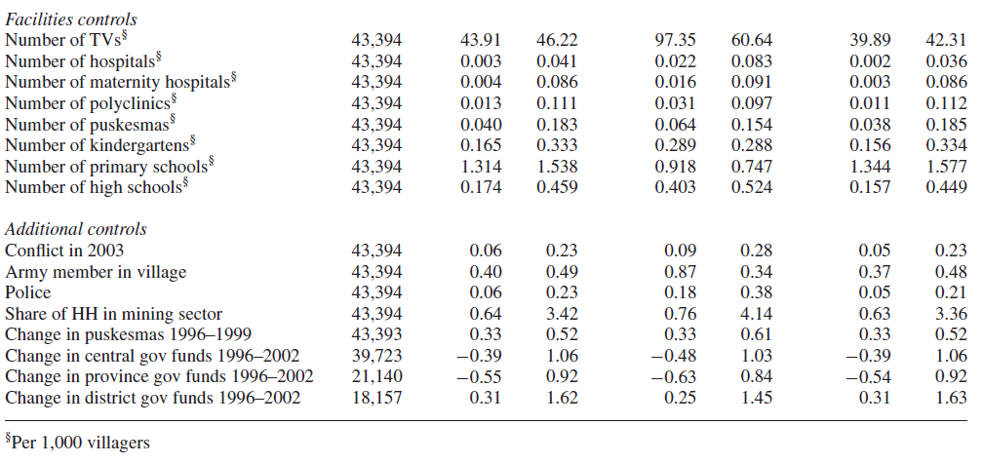
Data

Slide 14
Empirical Test on electoral results
No observation of the effort exerted by village heads
Comparing the electoral results of desa and kelurahan, within districts and controlling for the main determinants of voting behavior.
The underlying assumption is that once controlling for this host of factors, the two type of villages would have similar underlying political leanings.
Therefore, any remaining differences in voting behavior can presumably be attributable to the differential efforts of their village leaders.
Three main econometric methods are used in this empirical study: linear probability model (LPM), probit model, and propensity score matching.

Slide 15

Empirical Test on electoral results
LPM specification model:

Slide 16
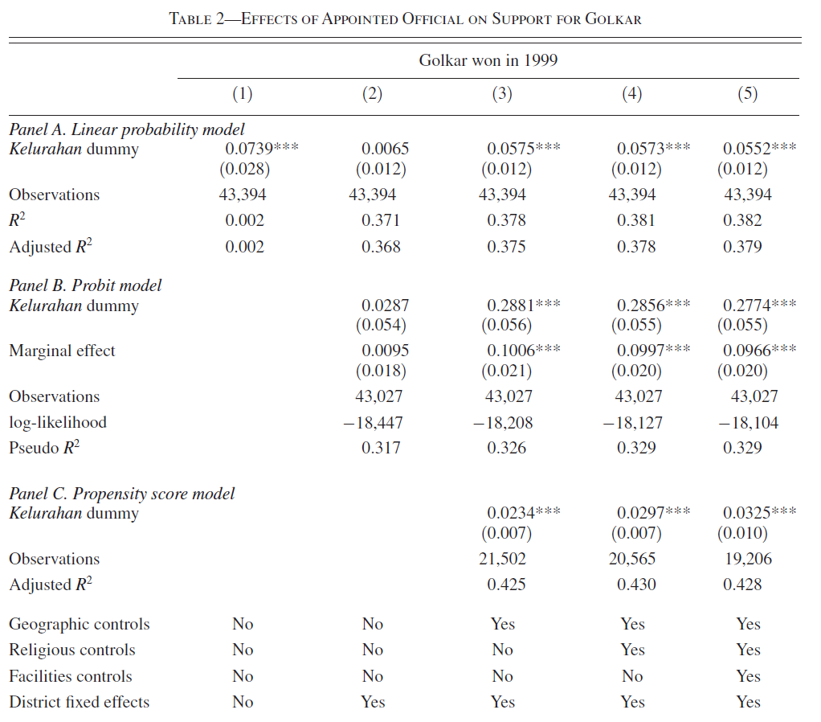
Results

Slide 17
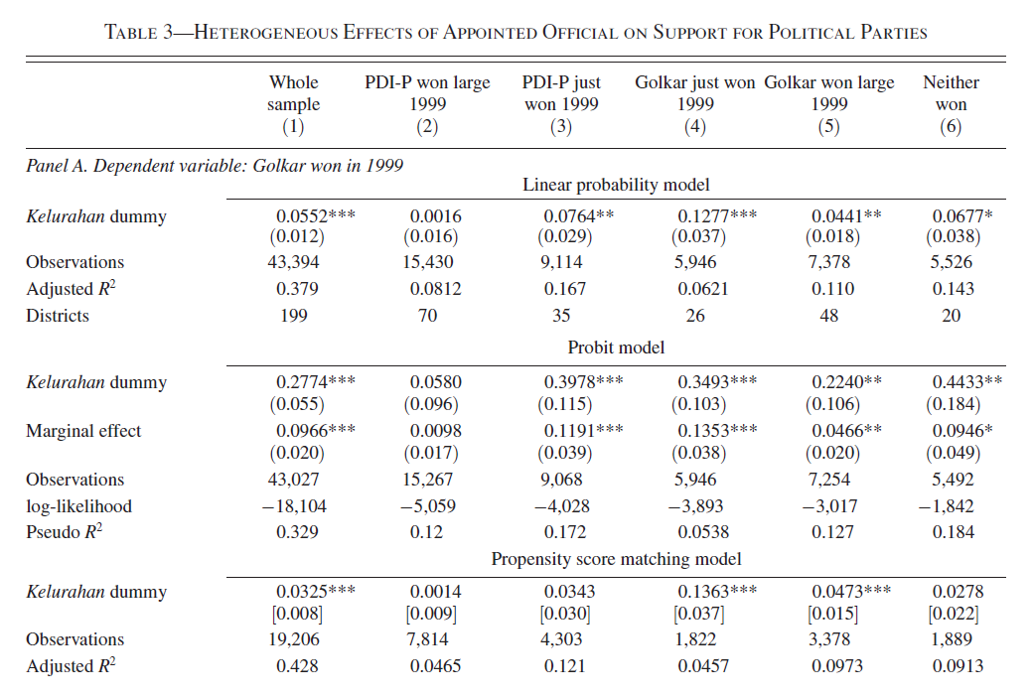
Results

Slide 18
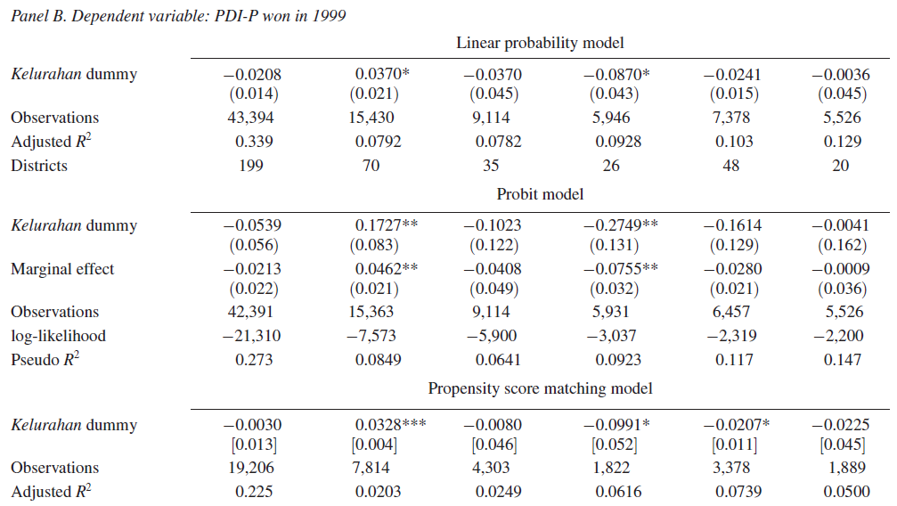
Results

Slide 19
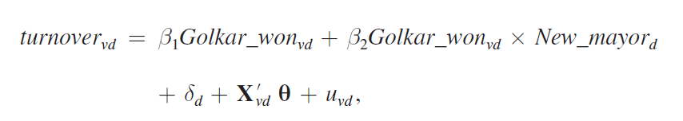
Empirical Test on Turnover of Village Heads
Coefficient β1 captures the predicted difference in the probability of turnover between a village in which Golkar was the most voted party in the 1999 election and a village in which another party was the most voted party, for districts where the new mayor did not take office by the year 2000.
The coefficient β2 captures the additional differences for districts in which a new mayor took office by the year 2000.

Slide 20
Empirical Test on Turnover of Village Heads
Hence, the theory makes unambiguous predictions regarding the sign of β 2 across districts.
In particular we expect β 2 ≈ 0 in districts in which either party won by a large
margin, while we expect β 2 > 0 in districts where PDI-P won by a tight margin and β 2 < 0 in districts where Golkar won by a tight margin.

Slide 21
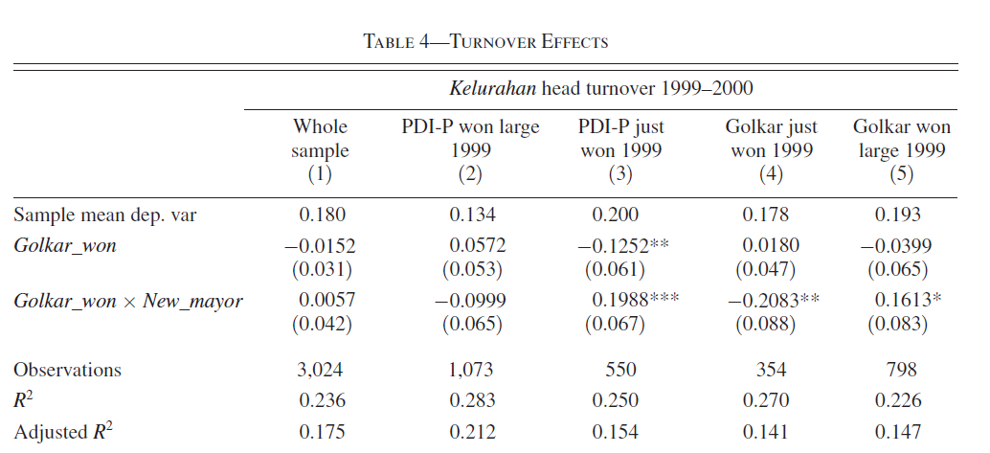
Results on Turnover

Slide 22
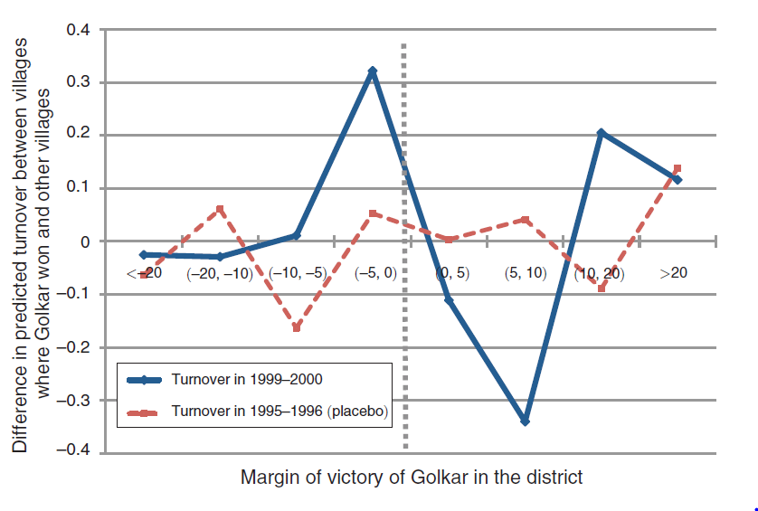
Results on Turnover

Slide 23
Discussion
Endogeneity of classification of villages into kelurahan and desa
The Soeharto regime might have been reluctant to classify as desa those villages where there was a strong opposition to the regime.

Slide 24
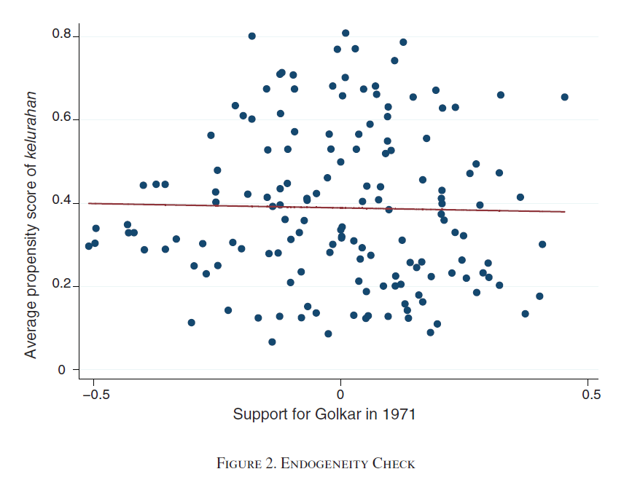

Slide 25
Discussion
Endogeneity between district electoral results and village district results
District mayors might distribute additional transfers or allocate public goods to kelurahan villages in which they obtained higher support in the election

Slide 26
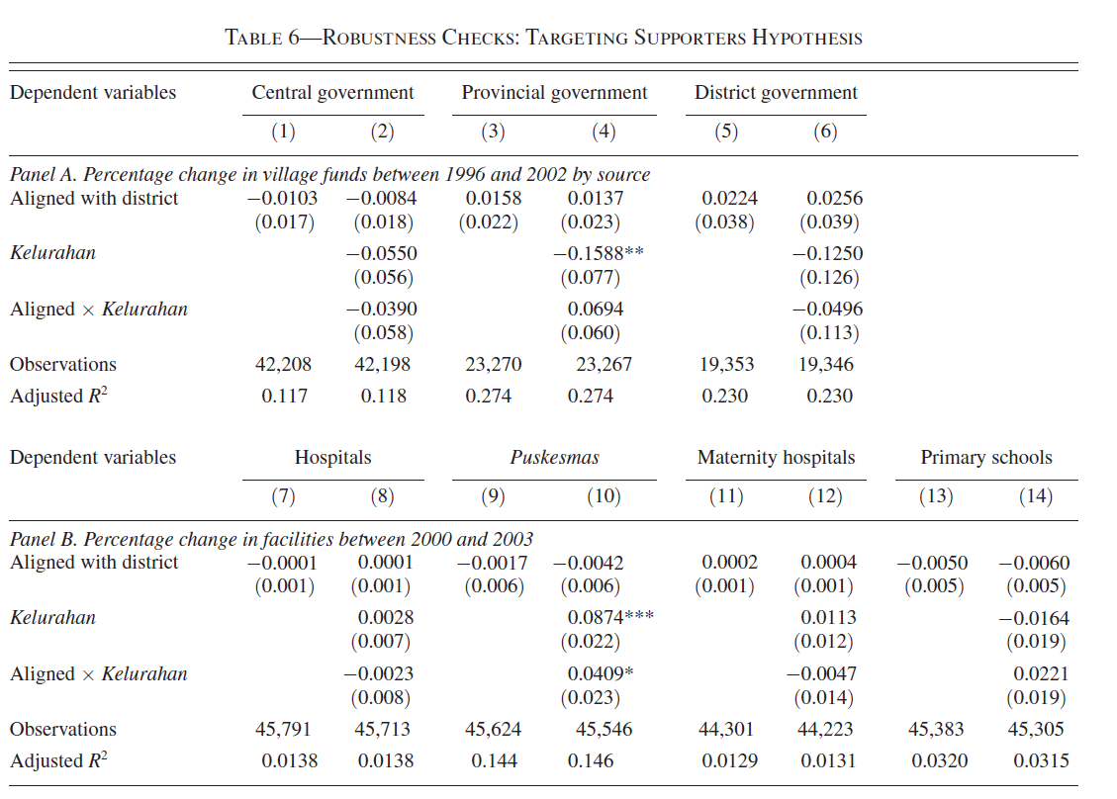

Slide 27
Conclusion
This paper presents a theoretical model that provides an intuitive interpretation:
Appointed village heads have stronger incentives to exert effort to manipulate voters because of their political career concerns.
In contrast, elected officials have far weaker incentives to exert effort because the continuity in their positions depends mainly on the will of their local constituents.
Evidence in subsequent turnover of appointed village heads also highly suggests that appointed officials coordinated in separating equilibria in close elections but on pooling equilibria in lopsided elections.

